Slide 1
What is Linear Algebra

Slide 2
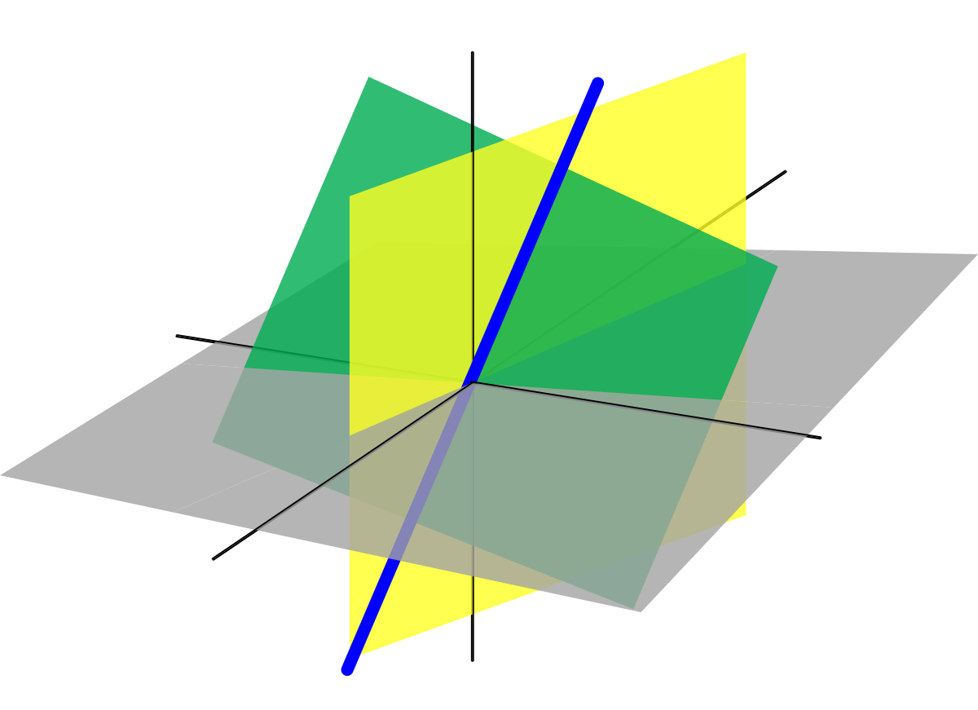
Linear Algebra is a branch of mathematics that lets you concisely describe coordinates and interactions of planes in higher dimensions and perform operations on them.

Slide 3
Why Study Linear Algebra?
Notes:
If Data Science was Batman, Linear Algebra would be Robin. This faithful sidekick is often ignored. But in reality, it powers major areas of Data Science including the hot fields of Natural Language Processing and Computer Vision.
I have personally seen a LOT of data science enthusiasts skip this subject because they find the math too difficult to understand. When the programming languages for data science offer a plethora of packages for working with data, people don’t bother much with linear algebra.
That’s a mistake. Linear algebra is behind all the powerful machine learning algorithms we are so familiar with. It is a vital cog in a data scientists’ skillset. As we will soon see, you should consider linear algebra as a must-know subject in data science.

Slide 4
Example
You want to reduce the dimensions of your data using Principal Component Analysis (PCA). How would you decide how many Principal Components to preserve if you did not know how it would affect your data? Clearly, you need to know the mechanics of the algorithm to make this decision.

Slide 5
Linear Algebra in Machine Learning
1. Loss Functions
You start with some arbitrary prediction function (a linear function for a Linear Regression Model)
Use it on the independent features of the data to predict the output
Calculate how far-off the predicted output is from the actual output
Use these calculated values to optimize your prediction function using some strategy like Gradient Descent
But wait – how can you calculate how different your prediction is from the expected output? Loss Functions, of course.
Notes:
You must be quite familiar with how a model, say a Linear Regression model, fits a given data:
You start with some arbitrary prediction function (a linear function for a Linear Regression Model)
Use it on the independent features of the data to predict the output
Calculate how far-off the predicted output is from the actual output
Use these calculated values to optimize your prediction function using some strategy like Gradient Descen

Slide 6
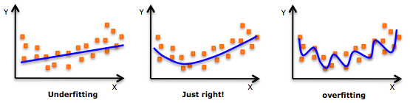
2. Regularization
Regularization is a very important concept in data science. It’s a technique we use to prevent models from overfitting. Regularization is actually another application of the Norm.
A model is said to overfit when it fits the training data too well.
Notes:
You must be quite familiar with how a model, say a Linear Regression model, fits a given data:
You start with some arbitrary prediction function (a linear function for a Linear Regression Model)
Use it on the independent features of the data to predict the output
Calculate how far-off the predicted output is from the actual output
Use these calculated values to optimize your prediction function using some strategy like Gradient Descen

Slide 7
3. Covariance Matrix
Bivariate analysis is an important step in data exploration. We want to study the relationship between pairs of variables. Covariance or Correlation are measures used to study relationships between two continuous variables.
Covariance indicates the direction of the linear relationship between the variables. A positive covariance indicates that an increase or decrease in one variable is accompanied by the same in another. A negative covariance indicates that an increase or decrease in one is accompanied by the opposite in the other.

Slide 8
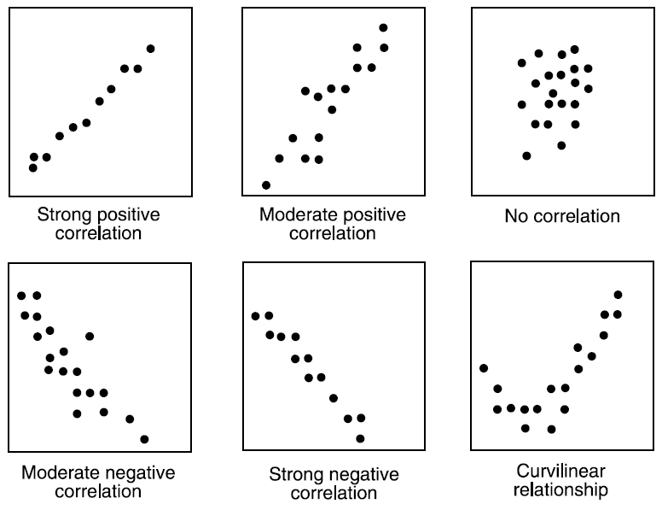

Slide 9
4. Support Vector Machine Classification
Support Vector Machine, or SVM, is a discriminative classifier that works by finding a decision surface. It is a supervised machine learning algorithm.

Slide 10
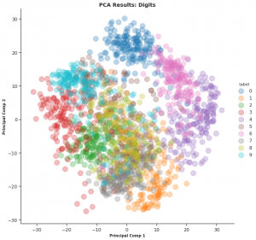
5. Principal Component Analysis (PCA)
Principal Component Analysis, or PCA, is an unsupervised dimensionality reduction technique. PCA finds the directions of maximum variance and projects the data along them to reduce the dimensions.

Slide 11
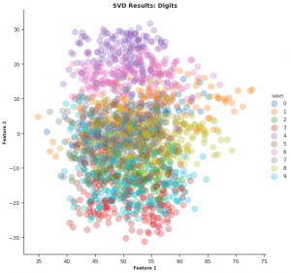
6. Singular Value Decomposition

Slide 12
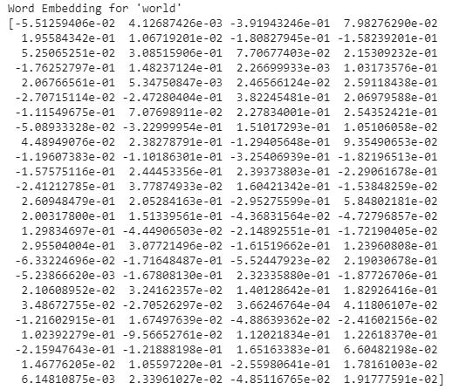
7. Word Embeddings
Word Embeddings is a way of representing words as low dimensional vectors of numbers while preserving their context in the document.

Slide 13
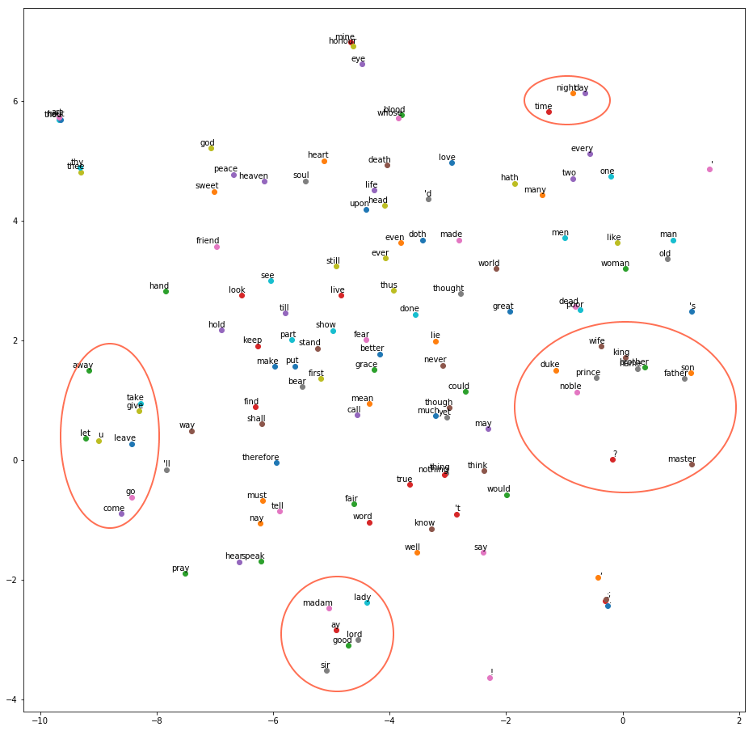

Slide 14
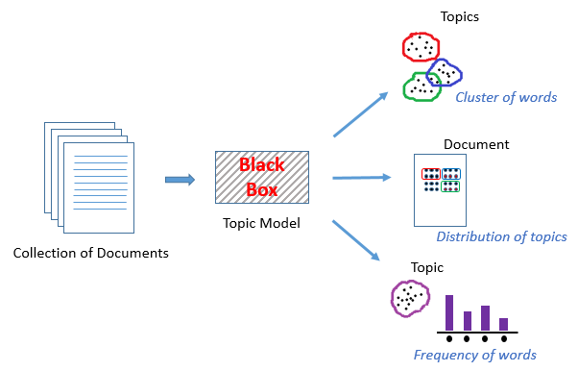
8. Latent Semantic Analysis (LSA)
Topic Modeling is an unsupervised technique to find topics across various text documents. These topics are nothing but clusters of related words. Each document can have multiple topics. The topic model outputs the various topics, their distributions in each document, and the frequency of different words it contains. Latent Semantic Analysis (LSA), or Latent Semantic Indexing, is one of the techniques of Topic Modeling.

Slide 15
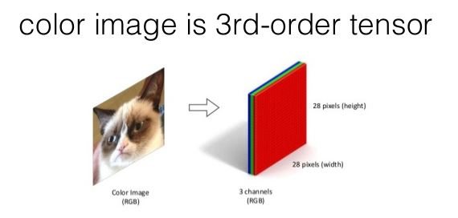
9. Image Representation as Tensors

Slide 16
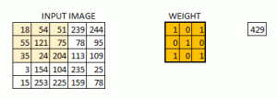
10. Convolution and Image Processing
2D Convolution is a very important operation in image processing. It consists of the below steps:
Start with a small matrix of weights, called a kernel or a filter
Slide this kernel on the 2D input data, performing element-wise multiplication
Add the obtained values and put the sum in a single output pixel
The function can seem a bit complex but it’s widely used for performing various image processing operations like sharpening and blurring the images and edge detection.

Slide 17
